Slide 1
Uncertainty in 3D reconstruction
Case study: Synagogue in Pilica
Lodz University of Technology
Miłosz Kazuła, Michał Majchrzak
2023

Slide 2
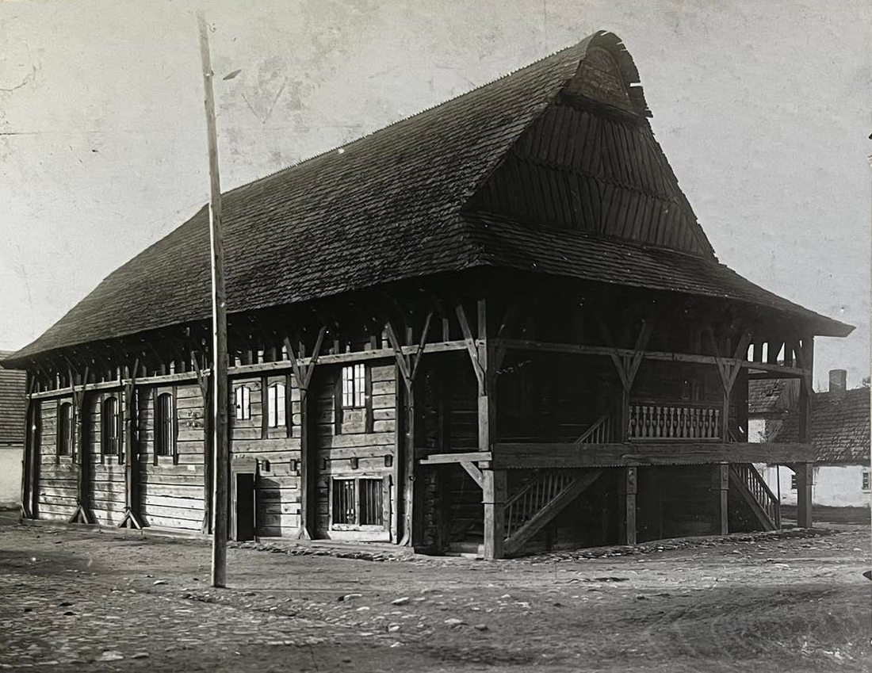
Synagogue in Pilica
Synagogue in Pilica was situated in Silesian Voivodeship. It probably have been constructed in the mid-18th century, although the precise architect remains unidentified. In the autumn of 1939, the temple was burned down by German military.
Uncertainty in 3D reconstruction - Synagogue in Pilica
Lodz University of Technology Miłosz Kazuła, Michał Majchrzak 2023

Slide 3
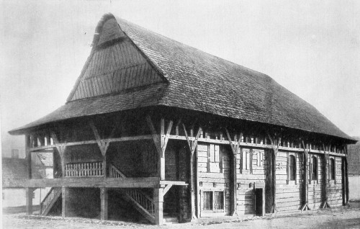
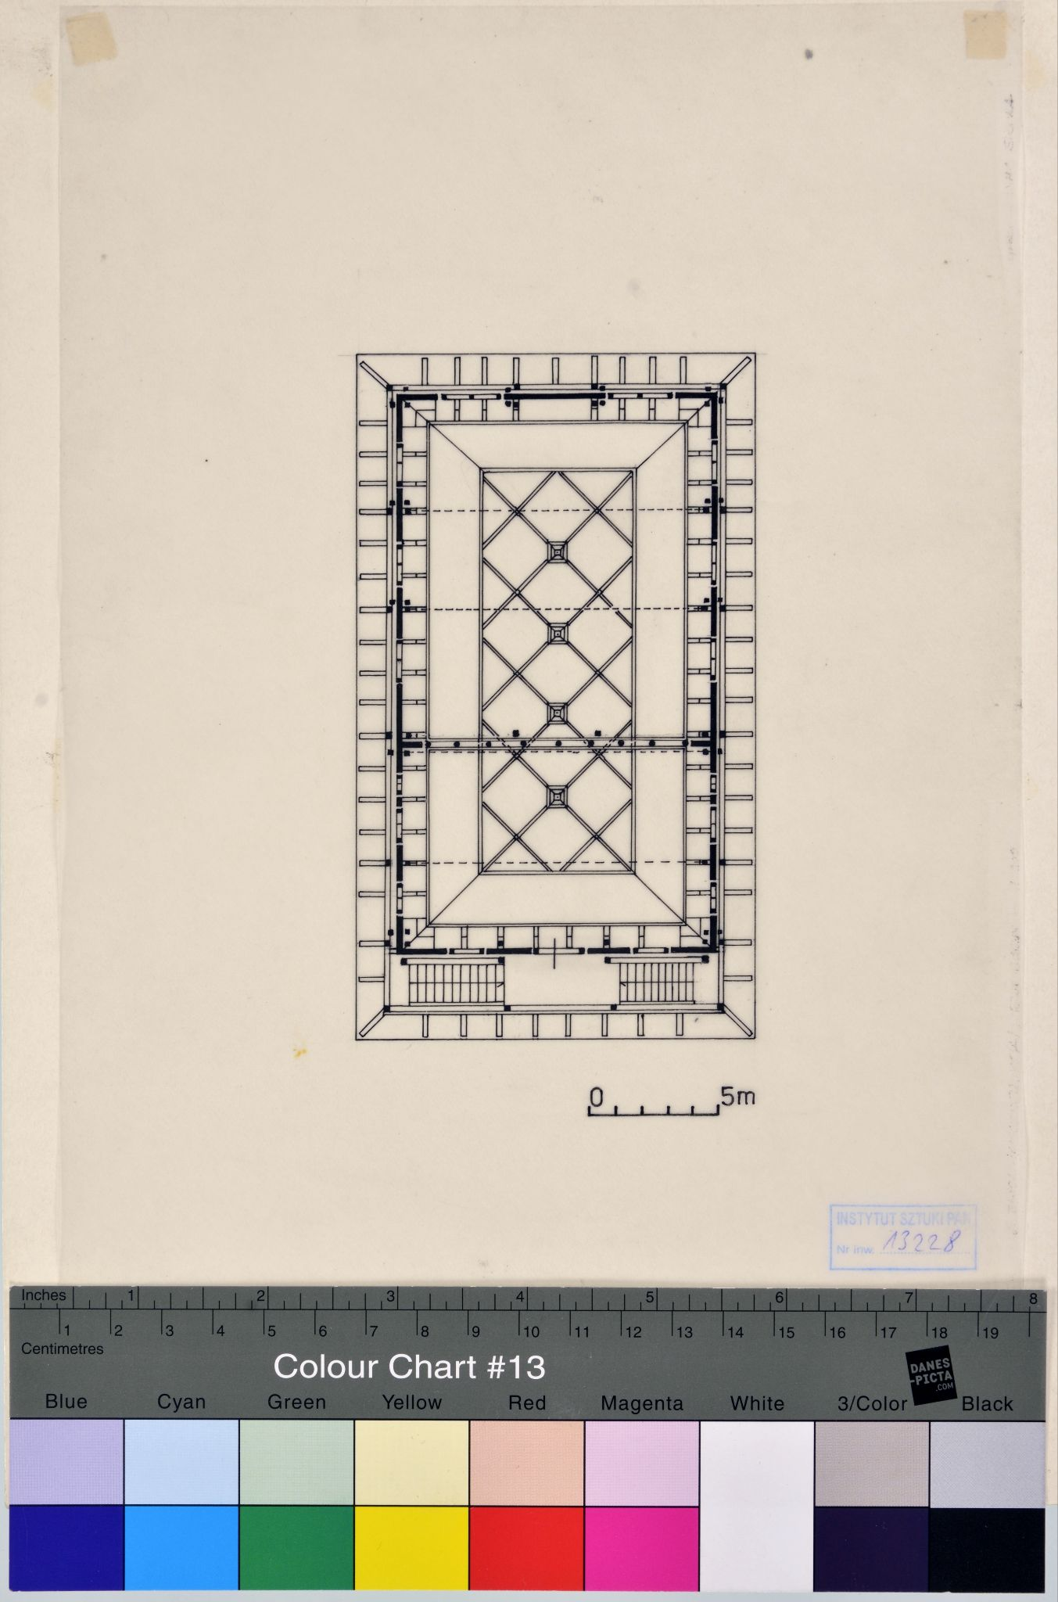
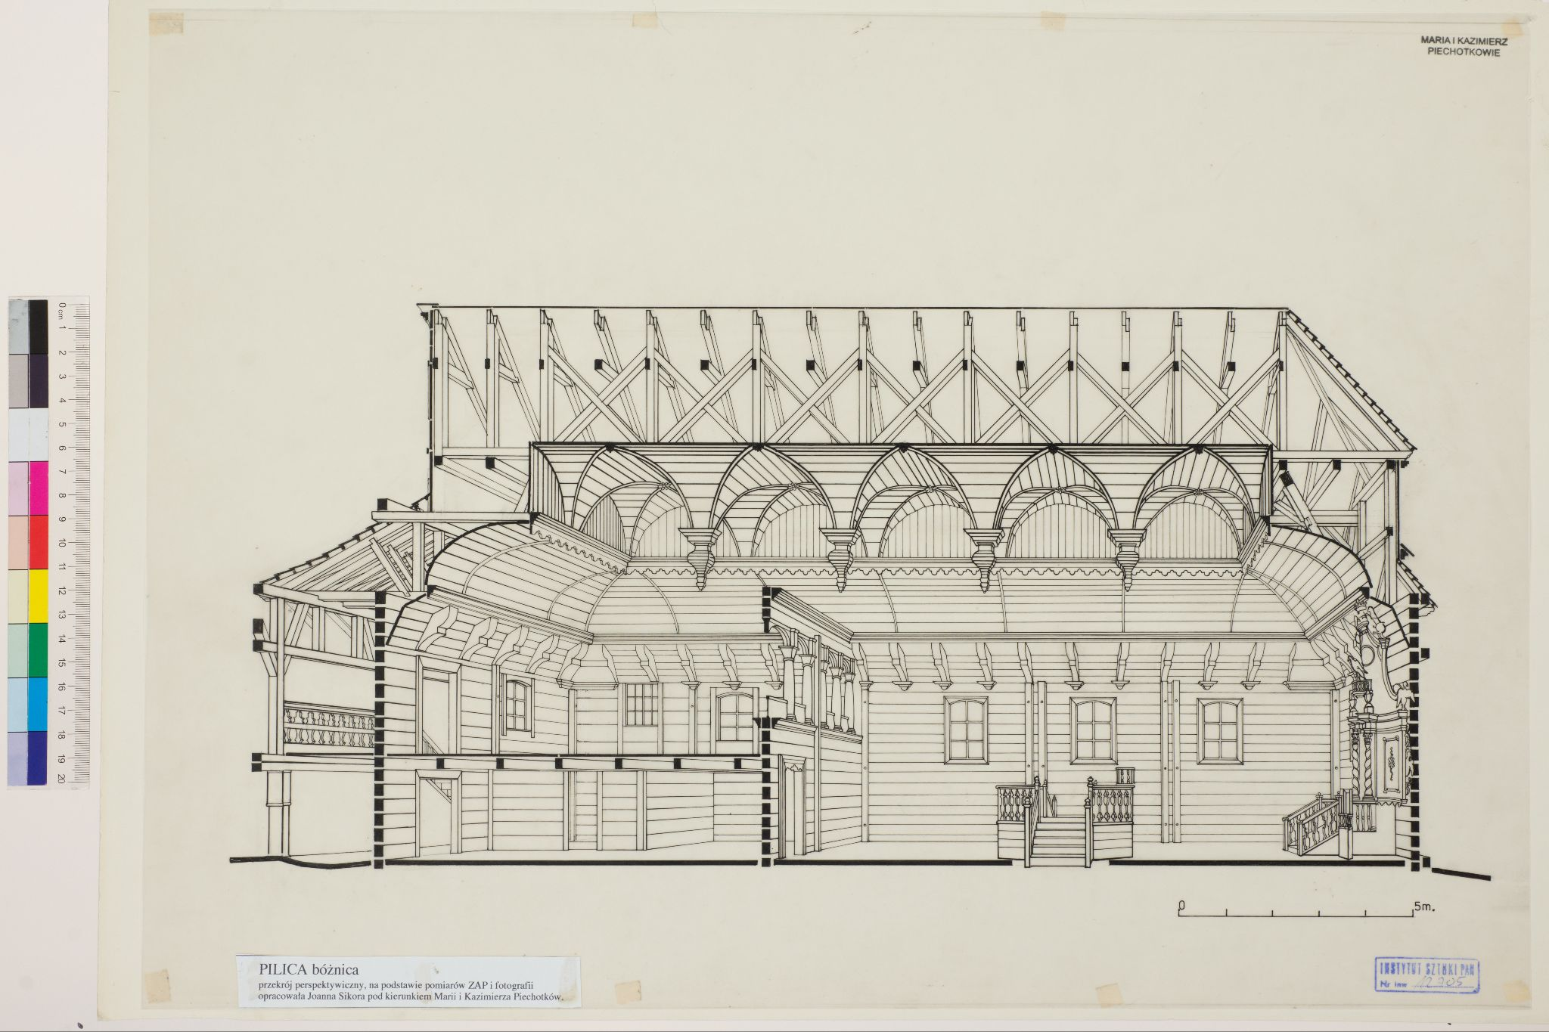
Source-based reconstruction
Due to the fact that the synagogue no longer exists, its reconstruction relies entirely on sources such as photographs and historical architectural drawings.
Uncertainty in 3D reconstruction - Synagogue in Pilica
Lodz University of Technology Miłosz Kazuła, Michał Majchrzak 2023

Slide 4
Evaluation criteria - bLOD
The quality of sources varies. Prior to commencing digital reconstruction, it is necessary to estimate the best possible Level of Details of reconstructed 3D model that can be achieved based on these sources (bLOD).
Approx. scale
bLOD
Explanation
Cubical geometry
1:500
1
General shapes of the objects
1:100
2
Main divisions within objects, characteristic elements
1:50
3
High level of details
1:10
4
All details
1:1
5

Slide 5
Evaluation criteria - Certainty
Another criterion requiring evaluation is the Certainty of the source; for example, a photograph carries greater certainty than a drawing, and an analogy within the same building is more reliable than an external analogy.
Explanation
C
Assumption
0
Oral report/external analogy
1
Analogy within the same building
2
Low quality photos
3
Historical surveys
4
Modern surveys, laser scanning, good quality photos
5

Slide 6

Source evaluation
The source is always evaluated in the context of a specific element, as the same source material may have different bLOD (Level of Detail) and C (Certainty) values for different elements.
less information
more information
For instance, the photograph on the right provides more information regarding the elements of the half-timbered construction than the partially shaded balustrade of the external staircase.
Uncertainty in 3D reconstruction - Synagogue in Pilica
Lodz University of Technology Miłosz Kazuła, Michał Majchrzak 2023

Slide 7
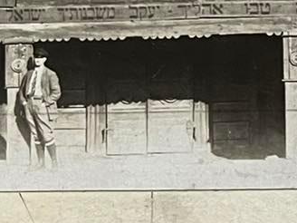
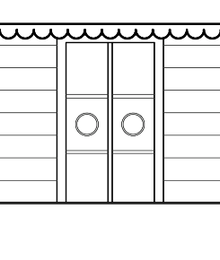
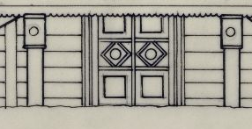
Exemplary source evaluation Main door
C
5
B
High quality of source
4
A
3
A
B
2
1
C
C
Low quality of source
1
2
3
4
5
bLOD
Uncertainty in 3D reconstruction - Synagogue in Pilica
Lodz University of Technology Miłosz Kazuła, Michał Majchrzak 2023

Slide 8
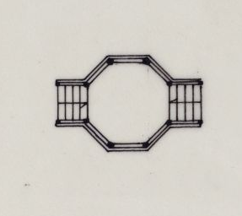
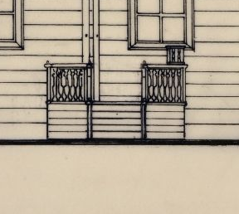
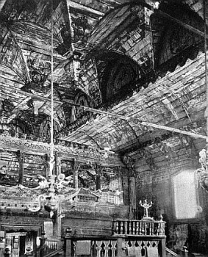
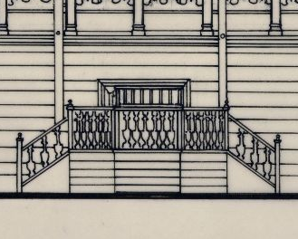
Exemplary source evaluation Bimah
C
5
E
High quality of source
4
A
A
3
B
C
D
D
2
B
1
Low quality of source
C
E
1
2
3
4
5
bLOD
Uncertainty in 3D reconstruction - Synagogue in Pilica
Lodz University of Technology Miłosz Kazuła, Michał Majchrzak 2023

Slide 9
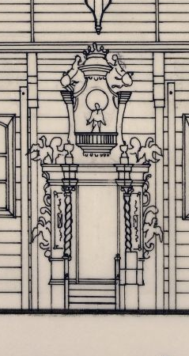
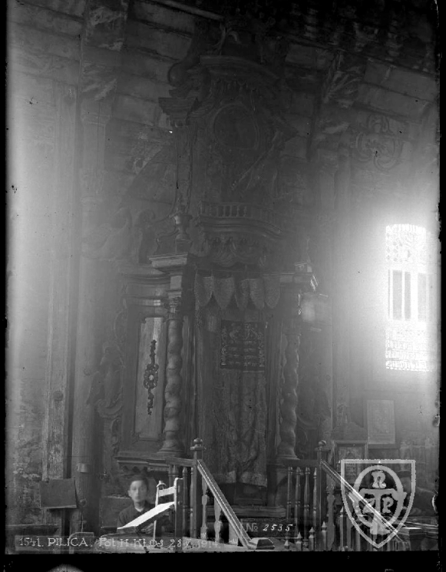
Exemplary source evaluation Aaron hakodesh
C
5
B
High quality of source
4
A
3
2
1
A
B
Low quality of source
1
2
3
4
5
bLOD
Uncertainty in 3D reconstruction - Synagogue in Pilica
Lodz University of Technology Miłosz Kazuła, Michał Majchrzak 2023

Slide 10
After evaluating the quality of sources, we proceed to the modeling stage. At this point, it is necessary to determine the desired mLOD (modelled Level of Detail) for each element of the reconstructed building.
Uncertainty in 3D reconstruction - Synagogue in Pilica
Lodz University of Technology Miłosz Kazuła, Michał Majchrzak 2023

Slide 11
Level of Hypothesis
After modeling we can determine the LOH (Level of Hypothesis) of given element of the building.
LOH is calculated in the following manner:
(modeled LOD) - (best possible LOD from sources) = LOH
more simplified
modelled exactly according to sources
more hypothetical
-4
-3
-2
-1
0
1
2
3
4
5
Uncertainty in 3D reconstruction - Synagogue in Pilica
Lodz University of Technology Miłosz Kazuła, Michał Majchrzak 2023

Slide 12
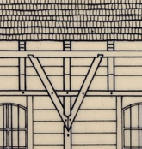
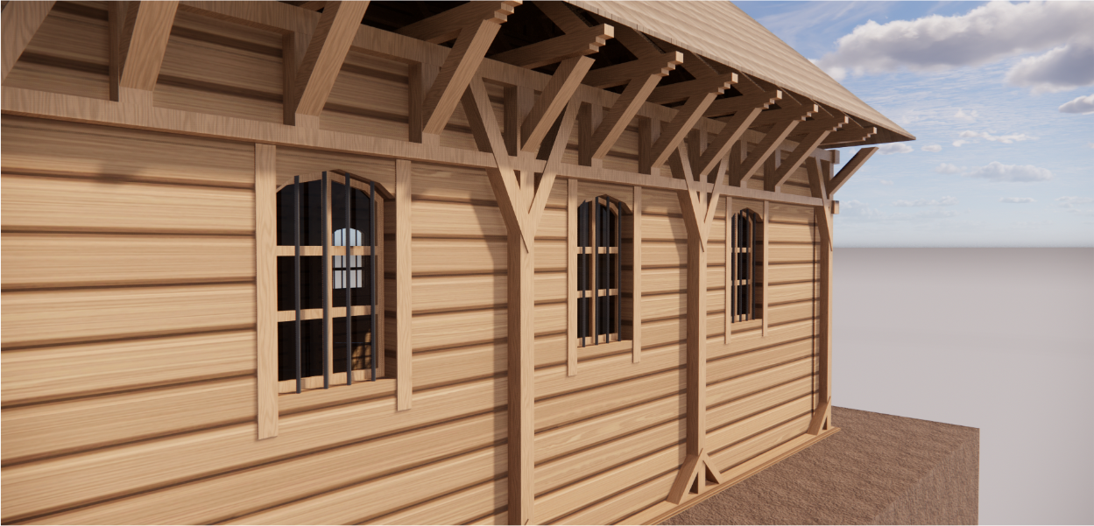
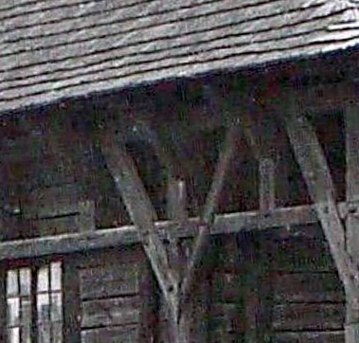
Scenario 1 - no hypothesis
We model the element exactly according to the sources.
If sources are good this is the most desired scenario.
mLOD is equal to bLOD.
bLOD = 4
C = 5
mLOD = 4
LOH = 0
LOH = 0
Uncertainty in 3D reconstruction - Synagogue in Pilica
Lodz University of Technology Miłosz Kazuła, Michał Majchrzak 2023

Slide 13
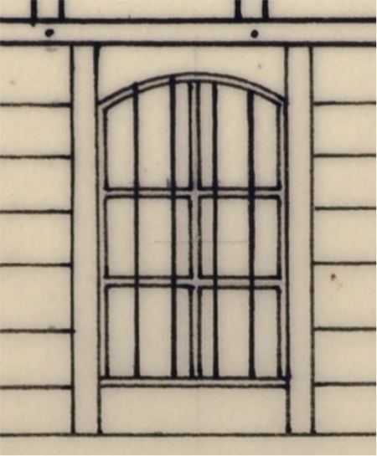
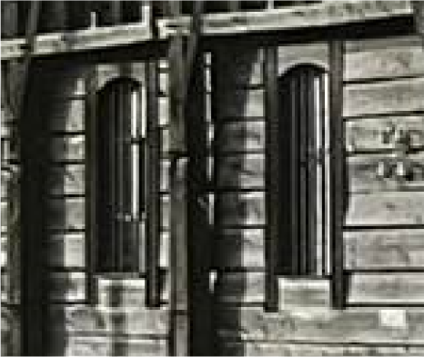
Scenario 2 - assumption
We model the element and add more details than is available from the sources (for example we resort to a form of analogy as a means of support). mLOD is greater than bLOD.
bLOD = 2 (little sources and
analogies availible)
C = 2 (analogy w. the
same building)
mLOD = 3
LOH = 1
NOTE: analogy!
LOH > 0
Uncertainty in 3D reconstruction - Synagogue in Pilica
Lodz University of Technology Miłosz Kazuła, Michał Majchrzak 2023

Slide 14
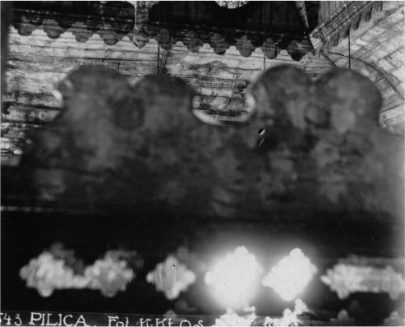
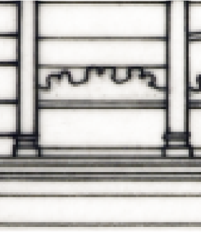
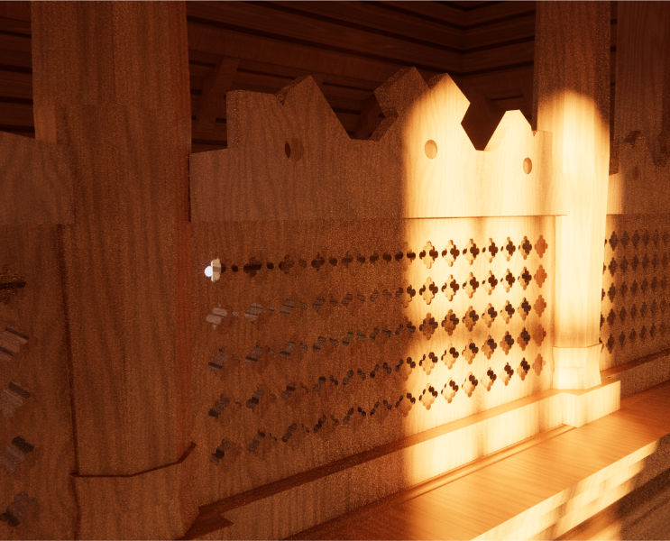
Scenario 3 - simplification
We model the element and downscale the LOD (for sake of lowering polygon amount in model or adjusting it to 3D print or AR). mLOD is lower than bLOD.
bLOD = 4
C = 5
mLOD = 3
LOH = -1
LOH < 0
Uncertainty in 3D reconstruction - Synagogue in Pilica
Lodz University of Technology Miłosz Kazuła, Michał Majchrzak 2023

